Slide 1
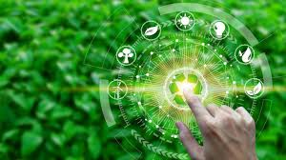
EOR - Ease of recycling
Team:
Lucas Nordgren
Anwar
Maryam Esmaeili Darestani
Deba Arif
Bassam
Mohammad

Slide 2

Why Stena Recycling Project?
Because:
We care about our environment.
Encourage people to go with greener options.
To help people who care about sustainable development.
We want to make a difference to our world.

Slide 3

Problems
Manufacture companies are not encouraged to use recycled materials.
Consumers does not have any clues about the materials used in their products.
There is no easy way for consumers to tell what is in a product, where it is from and if it is recyclable.

Slide 4
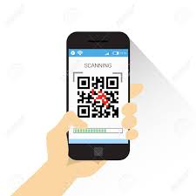
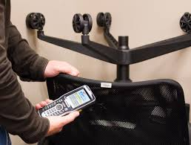
Solution
Use a barcode/QR-code scanner application on mobile phones.
Manufacture companies need to put a barcode/QR code on their items.

Slide 5
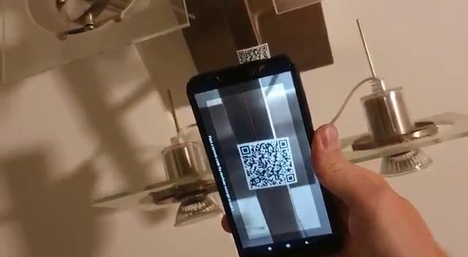
How Does It Work?

Slide 6
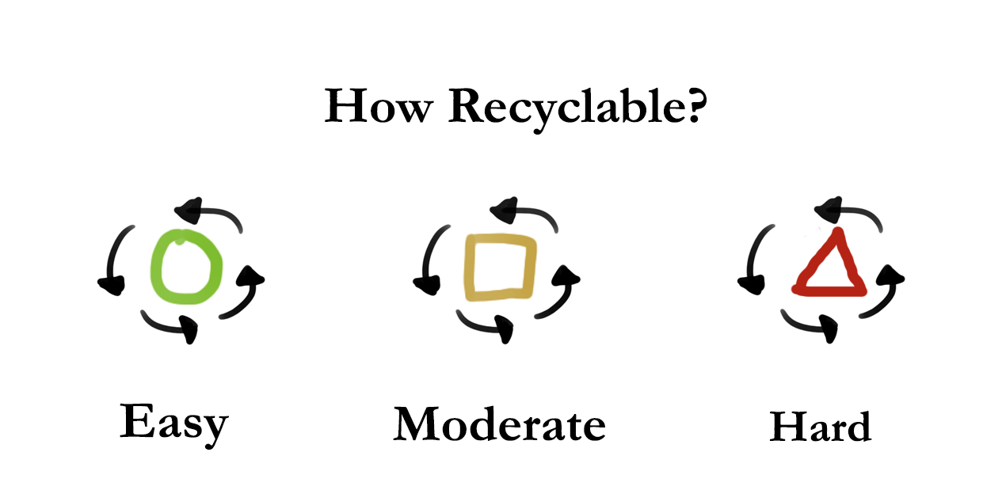
Future Goals
Notes:
Our own symbol with our own Scannable code.
Blind people: Embossed symbol

Slide 7
Why Our Solution?
Everyone has a phone and access to apps.
A user friendly app.
Accessibility to both Barcode and QR-code scanner.
Website for more detailed accessibility.

Slide 8

Cost
Google developer account.
No need for a server database.
Small server cost since information storage is not much.
Affordable to add these tags by manufacture companies.

Slide 9

Summary
Easy to implement.
Not much cost in upkeep.
The recycling symbols are user friendly.
Consumers get all the information they need.

Slide 10
Thank you, from EOR team <3

Slide 11
Links:
https://encrypted-tbn0.gstatic.com/images?q=tbn%3AANd9GcSoiDpXo4tKQzYPrtxgeG1OasxWlQBL0v7uwA&usqp=CAU
https://encrypted-tbn0.gstatic.com/images?q=tbn%3AANd9GcQRbN3FBZLPWde_fbZaKhNzKAvFCrT9QrjYtg&usqp=CAU
https://www.google.com/url?sa=i&url=https%3A%2F%2Fwww.gigatrak.com%2Ftrack-office-furniture%2F&psig=AOvVaw1XygwVLpWULdjY7TQQfOWD&ust=1598869438579000&source=images&cd=vfe&ved=2ahUKEwjZztn42sLrAhXDtKQKHbitChsQr4kDegUIARCpAQ
https://www.google.com/url?sa=i&url=https%3A%2F%2Fwww.123rf.com%2Fphoto_88646990_stock-vector-hand-hold-smart-phone-scanning-qr-code-icon-barcode-scan-with-telephone-vector-illustration.html&psig=AOvVaw0UlmBpDVL8p-N4Q4s7-3qJ&ust=1598869530631000&source=images&cd=vfe&ved=2ahUKEwj8g8yk28LrAhVJC-wKHQpDD3wQr4kDegUIARCxAQ
https://www.google.com/url?sa=i&url=https%3A%2F%2Ftoppng.com%2Fben-the-beneficiary-with-a-thought-bubble-over-his-person-asking-question-ico-PNG-free-PNG-Images_229274&psig=AOvVaw3krWSsfdMZSCE6DqT5BKQB&ust=1598869557578000&source=images&cd=vfe&ved=2ahUKEwiZ2bix28LrAhWK_aQKHS6QBagQr4kDegUIARDOAQ

